Slide 1


SENTIMENTPULSE
LIVE
By Team Spirit

Slide 2
TABLE OF CONTENTS
01
05
02
06
03
07
04
08
Team Member Roles and Responsibilities
Personas
Improvements
MVP
Project Description
Technologies
Team Working Agreement
Algorithms

Slide 3
TABLE OF CONTENTS
09
13
10
14
11
15
12
16
Diagrams & Sprint 1 Recap
Retrospective
Product Backlog
Sprint 2
Sprint 1 Backlog
Project Demo
Metrics
WikiPage Link and Live Demo

Slide 4



Team Member Roles and Responsibilities
Sandhya Reddy Kallem
Yashwanth Thalla
Dhruv Maheshbhai Ranpariya
Frontend developer
Backend Developer
Frontend Developer

Slide 5


Team Member Roles and Responsibilities
Hema Durga Prasad Chittala
Sravan Kumar Ganji
Backend Developer
Machine Learning Enginner

Slide 6
Improvements
Adding challenges in personas
Changes in the product backlog by adding story points
Adding id for sprint backlog
Keep the committed to completed around 80% to 90%
Fixing the burndown chart

Slide 7
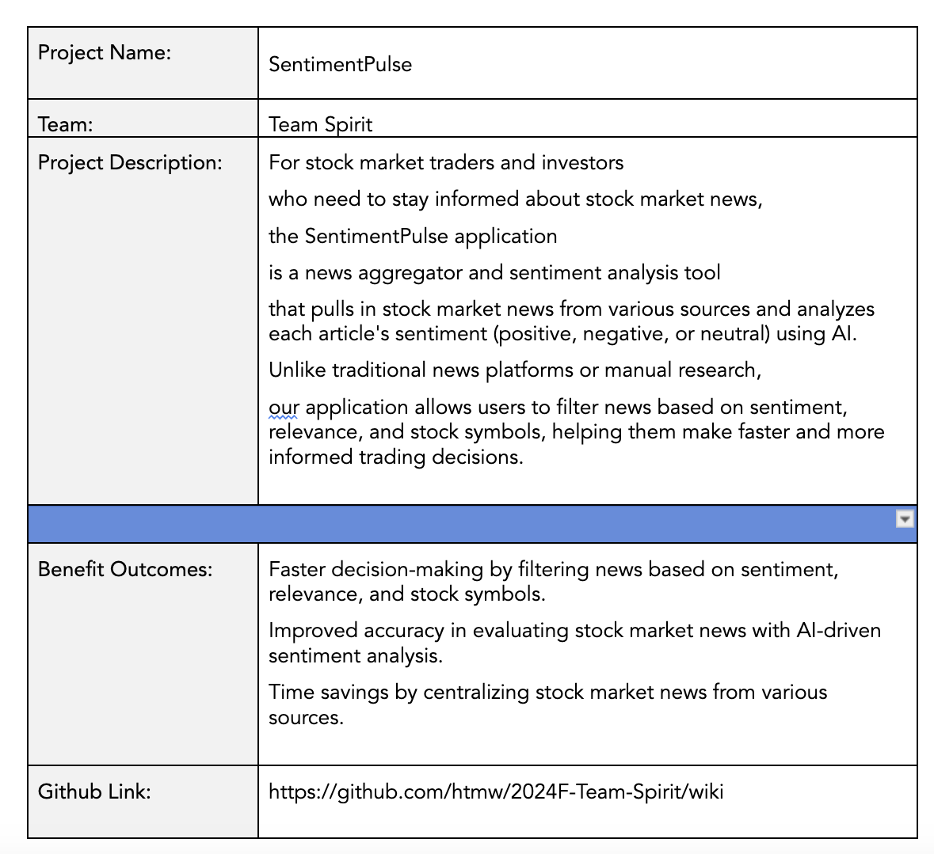
Project Description

Slide 8
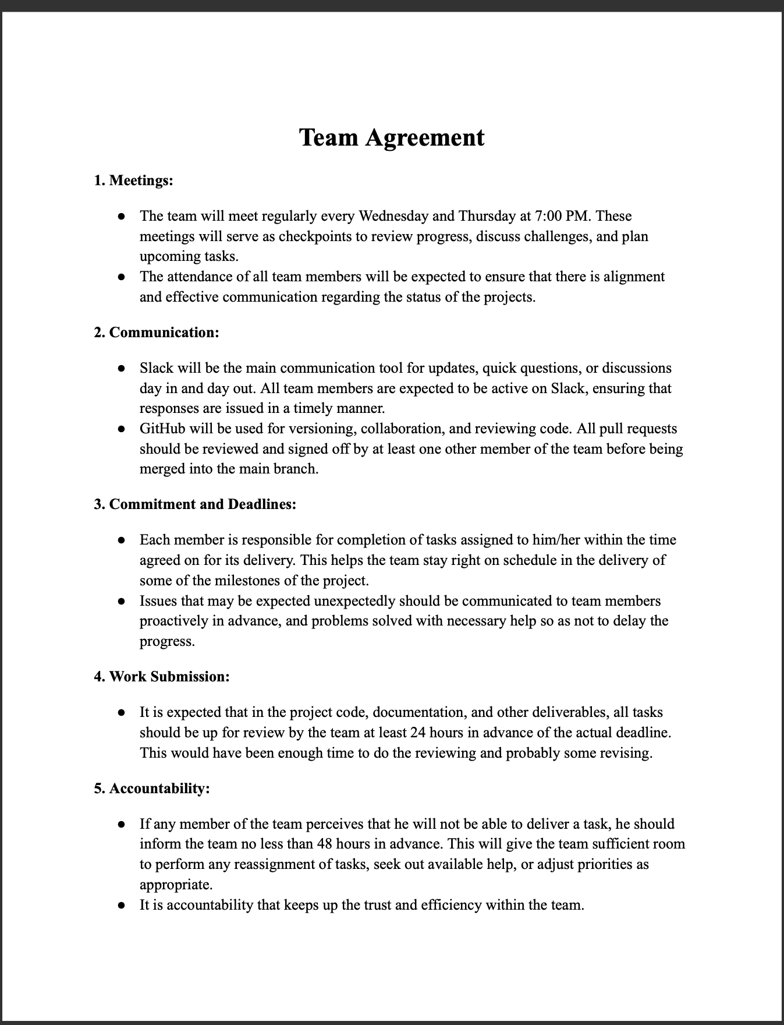
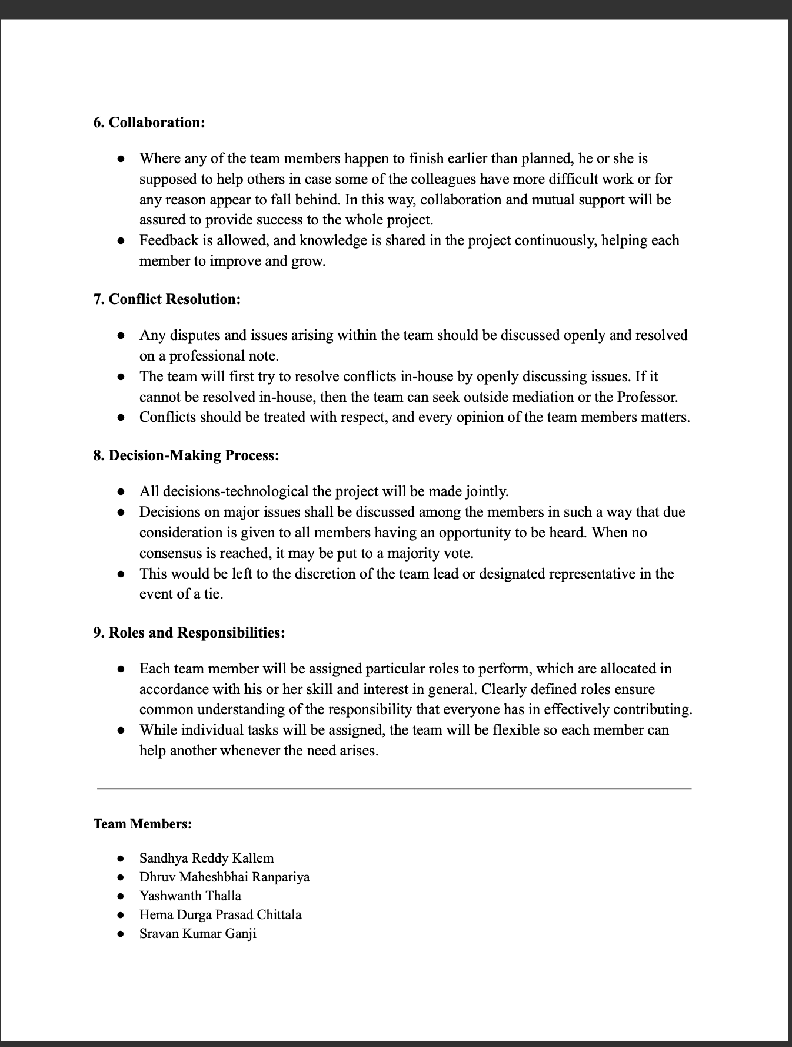
Team Agreement

Slide 9

Rajesh Verma (India)
Age: 35
Occupation: Software Engineer
Experience with Investing: 5 years
Location: Bengaluru, India
Investment Strategy: Focuses on Indian stocks with occasional investments in U.S. tech stocks. Primarily uses fundamental analysis and financial news.
Challenges: Rajesh’s demanding job leaves him with limited time to monitor markets, especially given his tech-heavy portfolio. He’s overwhelmed by the volume of news and struggles to quickly filter relevant insights, often missing timely opportunities.
Goal: To make faster, data-driven stock decisions using an AI tool that highlights relevant updates and fits his busy schedule.

Slide 10

Elsa Thompson (United States)
Age: 28
Occupation: Financial Analyst
Experience with Investing: 7 years
Location: New York, USA
Investment Strategy: Tracks energy and healthcare sectors, relying on research and sentiment data.
Challenges: Sorting through large volumes of news delays Elsa, leading to occasional missed insights. She finds it difficult to quickly identify sector-specific news that could impact her recommendations.
Goal: To improve her efficiency by using AI to prioritize critical news in her sectors, enabling more timely, insightful recommendations.

Slide 11

Lucas Müller (Germany, Europe)
Age: 45
Occupation: Independent Investor & Trader
Experience with Investing: 15 years
Location: Munich, Germany
Investment Strategy: Trades European and U.S. stocks, relying on global news.
Challenges: The global scope of his portfolio requires Lucas to keep up with a vast range of international events. He wants to reduce emotional trading and leverage AI-driven sentiment analysis to make quicker, objective decisions.
Goal: To use AI to filter impactful global news and provide sentiment insights, helping him trade more confidently and objectively.

Slide 12
Minimum Viable Product
News Aggregation Fetch and display financial news articles from reputable sources through APIs.
Sentiment Analysis Analyze the sentiment of each news article (positive, neutral, negative) using a sentiment analysis tool.
Company Mention Detection Identify and highlight companies referenced in the news articles.
User Interface Present the news articles, sentiment scores, and impacted companies in a clean, intuitive interface.

Slide 13
Technologies
Backend
Frontend
Database
Flask, Express JS
ReactJS
MongoDB
Machine Learning
API
Cloud Hosting
PyTorch, Huggingface
NewsAPI
GCP

Slide 14


Backend
What is it?
How is it used?
Flask is a lightweight Python web framework, and Express JS is a fast and minimalist web framework for Node.js.
Flask or Express JS will be used to handle backend logic, manage API requests, and serve data between the frontend and the database, enabling communication between the sentiment analysis AI and the stock market news aggregator.

Slide 15

Frontend
What is it?
How is it used?
ReactJS is a popular JavaScript library for building interactive user interfaces.
ReactJS will be used to build the web application's dynamic and responsive frontend, allowing users to interact with the platform, view stock market news, and access AI-driven sentiment insights.

Slide 16

DATABASE
What is it?
How is it used?
MongoDB is a NoSQL database designed for flexibility and scalability, storing data in JSON-like documents.
MongoDB will store news articles, user preferences, and AI-generated sentiment analysis, enabling fast retrieval and updates as new data comes in from the API.

Slide 17

Machine learning
What is it?
How is it used?
PyTorch is a machine learning framework, and Huggingface is a platform that provides pre-trained models and tools for NLP tasks.
PyTorch and Huggingface will be used to develop and deploy sentiment analysis models that process stock market news and classify the sentiment of each article (positive, neutral, or negative).

Slide 18
API
What is it?
How is it used?
NewsAPI is a service that provides access to news articles from various sources around the world.
NewsAPI will be integrated into the backend to pull relevant stock market news articles, which will be processed by the sentiment analysis model before being displayed to users.

Slide 19

Cloud Hosting
What is it?
How is it used?
Google Cloud Platform is a suite of cloud computing services that provides infrastructure for hosting applications.
GCP will host the web application, manage the backend servers, store data, and provide the resources necessary for running the machine learning models and API integrations efficiently.

Slide 20
Algorithm
What is BERT?
In what way is it applied?
BERT is an advanced Natural Language Processing (NLP) model developed by Google. It is formulated on the Transformer architecture and is devised to comprehend the context of a word in a sentence by studying it in both directions—left and right from the word—thus, it is very useful for sentiment analysis tasks, for example, understanding the sentiment of the text.
In the context of your project, BERT can be utilized through Huggingface to analyze stock market news articles and perform sentiment analysis. It will monitor the text and determine the sentiment(s) expressed in the news as positive, neutral, or negative. Therefore the technology enabling the categorization of each news piece and, consequently the provision of sentiment insights to the investors that quick assess of how the news may impact the stock performance. BERT's success in learning complex language patterns makes sentiment analysis more precise, which gives a more well-founded recommendation compared to the traditional NLP models.

Slide 21
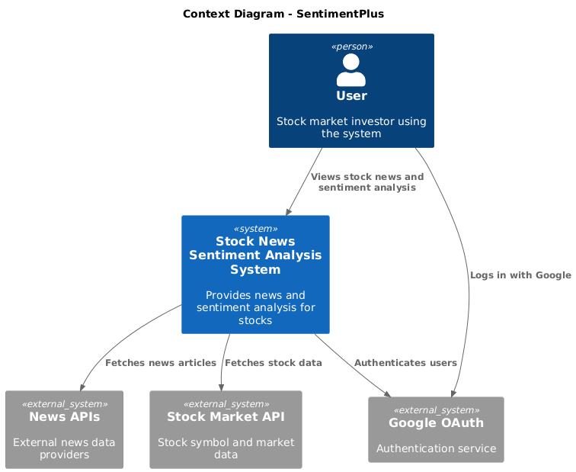
Context Diagram

Slide 22
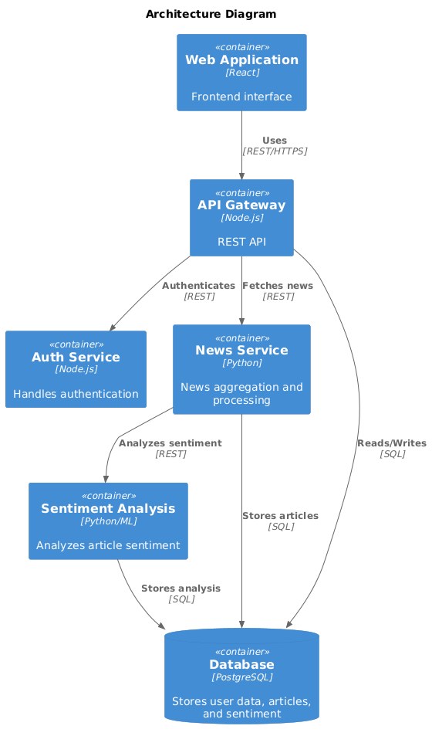
Architecture Diagram

Slide 23
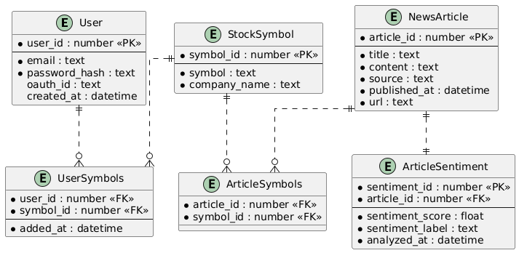
ER Diagram

Slide 24
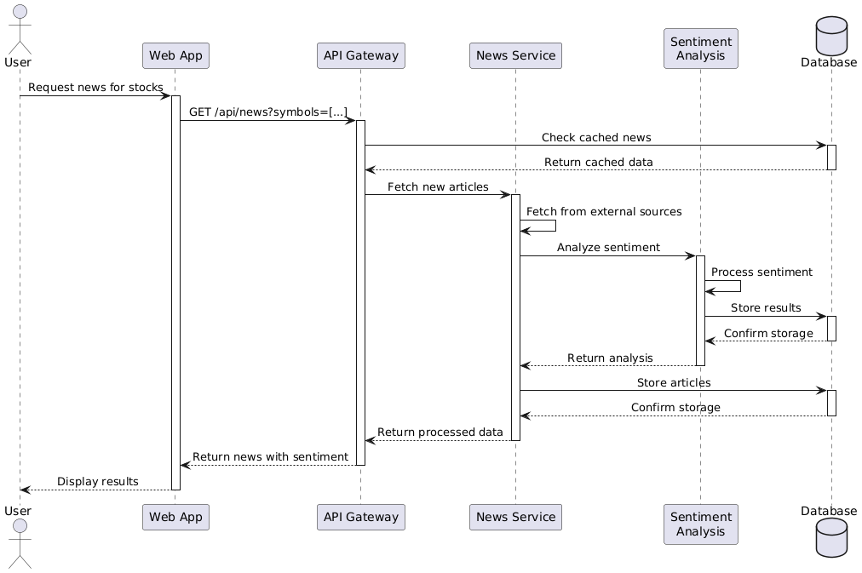
Sequence Diagram

Slide 25
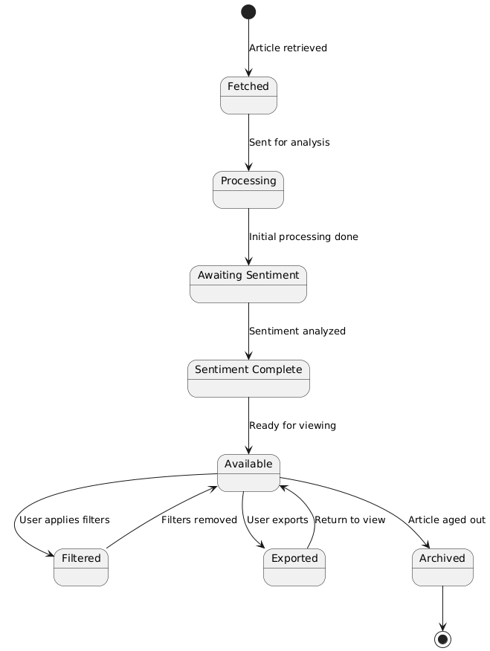
State Diagram

Slide 26
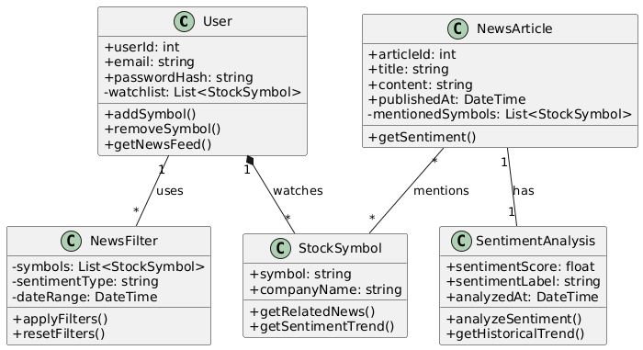
Class Diagram

Slide 27
Sprint 1 Recap
Completed Key Functionalities: All stories and technical tasks in Sprint 1 were completed, including stock symbol input, news filtering by stock symbols, chronological display of articles, relevance-based filtering, and backend setup for news aggregation.
Achieved 100% Completion Ratio: The sprint achieved a 100% completion rate, with all committed 31 story points completed.
Effective Database Setup and Backend Functionality: The backend was successfully configured to fetch news from multiple sources, and a robust database structure was implemented to support user profiles, stock symbols, and news article data.

Slide 28
Product Backlog
ID | Description | Acceptance Criteria | Feature | Story Points
US1.1 | As an investor, I want to input stock symbols of interest to receive relevant news articles. | Users can search and input stock symbols. Stock symbols stored and shown on dashboard. | Stock Symbols | 5
US1.2 | As an investor, I want to view a list of news articles related to the stock symbols I've selected. | Articles are filtered by stock symbols. News displayed in chronological order. | News Feed | 8
US1.3 | As an investor, I want to filter news articles by relevance to my stock symbols to focus on the most important articles. | News ranked by relevance to stock symbols. Filter option for relevant articles only. | News Relevance Filter | 5
TT1.4 | Backend developer sets up infrastructure for news aggregation and stock symbol search. | API fetches news from 3 sources. Backend handles stock searches and storage. | Backend Infrastructure | 8
TT1.5 | Database administrator establishes database structure for user profiles, stock symbols, and news articles. | Create tables for users, symbols, articles. Ensure user-stock preferences are linked. | Database Setup | 5

Slide 29
Product Backlog
ID | Description | Acceptance Criteria | Feature | Story Points
US2.1 | As an investor, I want to log in securely to access personalized sentiment analysis. | Users log in with email/password. Support Google OAuth login. | Authentication | 8
US2.2 | As an investor, I want each news article to display a sentiment rating (positive) to gauge its emotional tone. | Sentiment rating visible for each article. Sentiment rating is easy to understand. | Sentiment Analysis | 5
US2.3 | As an investor, I want each news article to display a sentiment rating (negative) to gauge its emotional tone. | Sentiment rating visible for each article. Sentiment rating is easy to understand. | Sentiment Analysis | 5
US2.4 | As an investor, I want each news article to display a sentiment rating (neutral) to gauge its emotional tone. | Sentiment rating visible for each article. Sentiment rating is easy to understand. | Sentiment Analysis | 5
US2.5 | As an investor, I want to filter news articles by sentiment type to focus on specific tones (e.g., positive news). | Filter by positive, negative, neutral. Dynamic UI update when filtering. | Sentiment Filter | 5

Slide 30
Product Backlog
ID | Description | Acceptance Criteria | Feature | Story Points
TT2.6 | Developer integrates AI sentiment analysis engine for news articles. | AI assigns sentiment to articles. AI achieves 80% accuracy or higher. | Sentiment Analysis Engine | 8
TT2.7 | Developer implements user authentication system (login and OAuth). | Implement login with email/password. Add OAuth for social logins. | Authentication | 13
TT2.8 | Developer connects backend to sentiment analysis model. | API connects backend to sentiment model. Ensure real-time sentiment processing. | Backend Integration | 3
US3.1 | As an investor, I want to filter articles based on both stock symbols and sentiment to focus on the best insights for my trading decisions. | Apply filters for symbols and sentiment. Filtered news updates in real time. | Combined Filtering | 5
US3.2 | As an investor, I want to export sentiment analysis and news data to a CSV file to analyze it offline. | Provide option to export data to CSV. Export includes stock, sentiment, and news. | Data Export | 3

Slide 31
Product Backlog
ID | Description | Acceptance Criteria | Feature | Story Points
US3.3 | As an investor, I want to view historical sentiment trends for a particular stock symbol to analyze long-term market sentiment. | Sentiment trends shown graphically. View trends for different time periods. | Historical Trends | 8
US3.4 | As an investor, I want to reset all filters easily to return to the full, unfiltered news feed. | Provide a clear option to reset filters. Reset clears all active filters. | Filter Reset | 2
TT3.5 | Developer implements historical sentiment tracking and visualization. | Track and store historical sentiment. Display trends using a graph. | Historical Sentiment Graph | 8
TT3.6 | Developer improves frontend performance and responsiveness. | Optimize UI for mobile and desktop. Ensure fast filter application. | Frontend Optimization | 5

Slide 32
Sprint 2 Backlog
ID | Description | Acceptance Criteria | Feature | Story Points
US2.1 | As an investor, I want to log in securely to access personalized sentiment analysis. | Users log in with email/password. Support Google OAuth login. | Authentication | 8
US2.2 | As an investor, I want each news article to display a sentiment rating (positive) to gauge its emotional tone. | Sentiment rating visible for each article. Sentiment rating is easy to understand. | Sentiment Analysis | 5
US2.3 | As an investor, I want each news article to display a sentiment rating (negative) to gauge its emotional tone. | Sentiment rating visible for each article. Sentiment rating is easy to understand. | Sentiment Analysis | 5
US2.4 | As an investor, I want each news article to display a sentiment rating (neutral) to gauge its emotional tone. | Sentiment rating visible for each article. Sentiment rating is easy to understand. | Sentiment Analysis | 5
US2.5 | As an investor, I want to filter news articles by sentiment type to focus on specific tones (e.g., positive news). | Filter by positive, negative, neutral. Dynamic UI update when filtering. | Sentiment Filter | 5

Slide 33
Sprint 2 Backlog
ID | Description | Acceptance Criteria | Feature | Story Points
TT2.6 | Developer integrates AI sentiment analysis engine for news articles. | AI assigns sentiment to articles. AI achieves 80% accuracy or higher. | Sentiment Analysis Engine | 8
TT2.7 | Developer implements user authentication system (login and OAuth). | Implement login with email/password. Add OAuth for social logins. | Authentication | 13
TT2.8 | Developer connects backend to sentiment analysis model. | API connects backend to sentiment model. Ensure real-time sentiment processing. | Backend Integration | 3

Slide 34
Test Cases
Test Case ID | ID | Test Case Description | Expected Result | Actual Result | Pass/Fail
TC1 | US2.1 | Test secure login with valid email/password credentials | User successfully logs in and is redirected to the dashboard. | User logged in but was not redirected to the dashboard. | Pass
TC2 | US2.1 | Test secure login with invalid email/password credentials | User receives an error message indicating invalid credentials. | User received correct error message. | Pass
TC3 | US2.1 | Test secure login using Google OAuth | User successfully logs in with Google and is redirected to the dashboard. | User logged in and redirected successfully. | Fail
TC4 | US2.2 | Test sentiment rating display for positive news article | Positive sentiment rating is displayed clearly and accurately for the article. | Sentiment rating displayed correctly. | Pass
TC5 | US2.3 | Test sentiment rating display for negative news article | Negative sentiment rating is displayed clearly and accurately for the article. | Sentiment rating not visible on the article page. | Pass

Slide 35
Test Cases
Test Case ID | ID | Test Case Description | Expected Result | Actual Result | Pass/Fail
TC6 | US2.4 | Test sentiment rating display for neutral news article | Neutral sentiment rating is displayed clearly and accurately for the article. | Sentiment rating displayed correctly. | Pass
TC7 | US2.5 | Test filter for positive sentiment news articles | Only positive sentiment news articles are displayed after filtering. | Displayed positive sentiment articles as expected. | Pass
TC8 | US2.5 | Test filter for negative sentiment news articles | Only negative sentiment news articles are displayed after filtering. | Displayed articles with mixed sentiment, including positive and neutral. | Pass
TC9 | US2.5 | Test filter for neutral sentiment news articles | Only neutral sentiment news articles are displayed after filtering. | Displayed only neutral sentiment articles. | Pass
TC10 | TT2.6 | Test AI sentiment analysis engine for accuracy in classifying news articles | AI correctly classifies articles with at least 80% accuracy. | AI classification accuracy was 76%. | Fail

Slide 36
Test Cases
Test Case ID | ID | Test Case Description | Expected Result | Actual Result | Pass/Fail
TC11 | TT2.6 | Test AI sentiment analysis on different types of news articles (positive, negative, neutral) | AI assigns correct sentiment rating to each article type (positive, negative, neutral). | AI sentiment classifications matched expected results. | Pass
TC12 | TT2.7 | Test login system with valid email/password and OAuth for user authentication | Users can log in using either email/password or OAuth without issues. | User successfully logged in with both methods. | Pass
TC13 | TT2.7 | Test login system with incorrect credentials or expired OAuth | User receives a proper error message indicating login failure. | User received incorrect error message for expired OAuth. | Fail
TC14 | TT2.8 | Test backend integration with sentiment analysis model for real-time processing | API successfully connects to the sentiment model and processes sentiment in real time. | API connected and processed sentiment data in real time. | Pass
TC15 | TT2.8 | Test latency for sentiment analysis API call from backend | Sentiment analysis completes within acceptable time limits (real-time processing). | Latency was above acceptable limits, causing a delay in sentiment analysis. | Fail

Slide 37
Stories Completed
ID | Feature | Description | Test Case IDs
US2.1 | Authentication | Log in securely to access personalized sentiment analysis. | TC2, TC3
US2.2 | Sentiment Analysis | Display sentiment rating (positive) for news articles. | TC4
US2.4 | Sentiment Analysis | Display sentiment rating (neutral) for news articles. | TC6
US2.5 | Sentiment Filter | Filter news articles by specific sentiment types (e.g., positive, negative, neutral). | TC7, TC9
TT2.6 | Sentiment Analysis Engine | Test AI sentiment analysis on different types of news articles (positive, negative, neutral). | TC11
TT2.7 | Authentication | Implement user authentication with both email/password and OAuth. | TC12
TT2.8 | Backend Integration | Integrate backend with sentiment analysis model for real-time processing. | TC14

Slide 38
Stories Not Completed
ID | Feature | Description | Test Case IDs
US2.1 | Authentication | Log in securely to access personalized sentiment analysis. | TC1
US2.3 | Sentiment Analysis | Display sentiment rating (negative) for news articles. | TC5
TT2.6 | Sentiment Analysis Engine | Ensure AI sentiment analysis engine achieves 80% accuracy in classifying news articles. | TC10
TT2.7 | Authentication | Display correct error message for expired OAuth credentials during login. | TC13
TT2.8 | Backend Integration | Ensure latency for sentiment analysis API call from backend remains within acceptable limits. | TC15

Slide 39
Team Velocity - This Sprint
Total Story Points Completed: 52 points

Slide 40
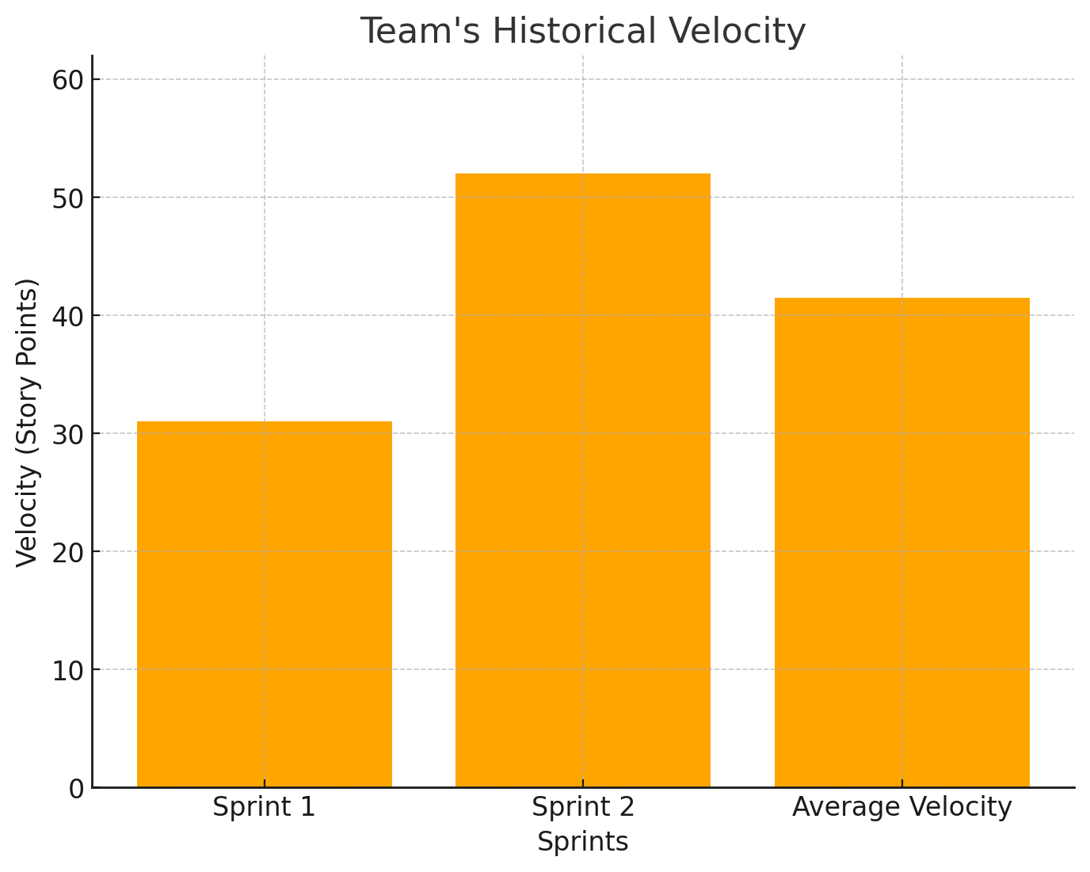
Team's historical velocity (average)

Slide 41
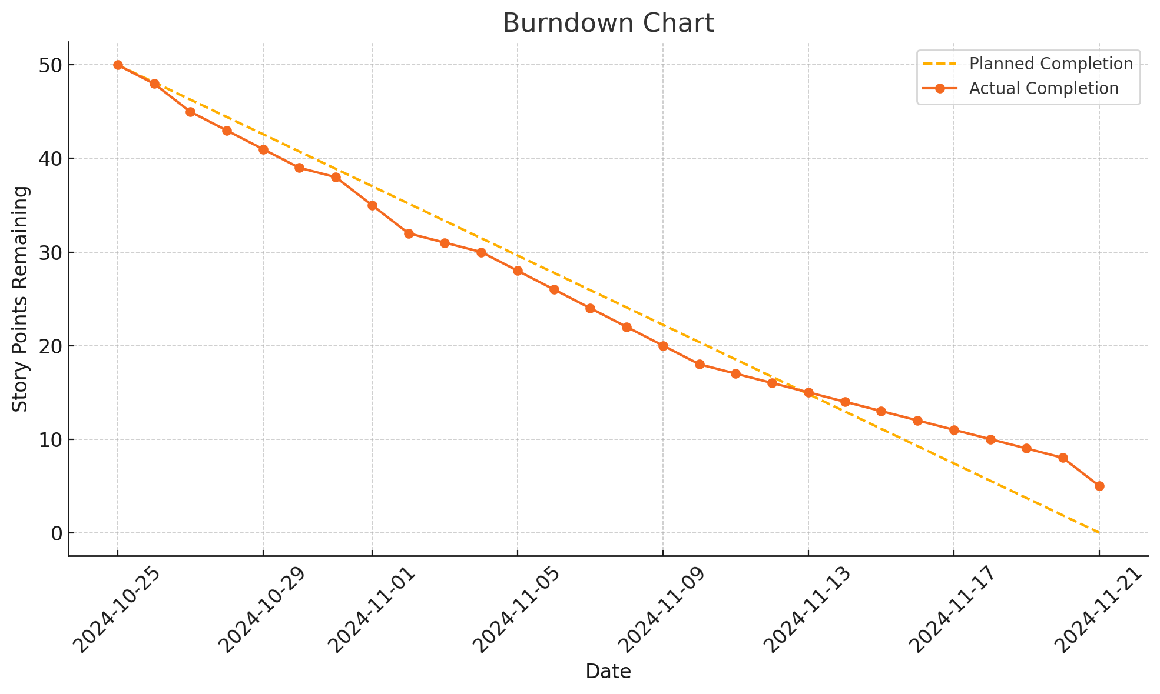
Burndown Chart

Slide 42
Completed/Committed Ratio
Completed Story Points: 47
Committed Story Points: 52
So, the ratio is:
47/52=0.90 or 90.4%

Slide 43
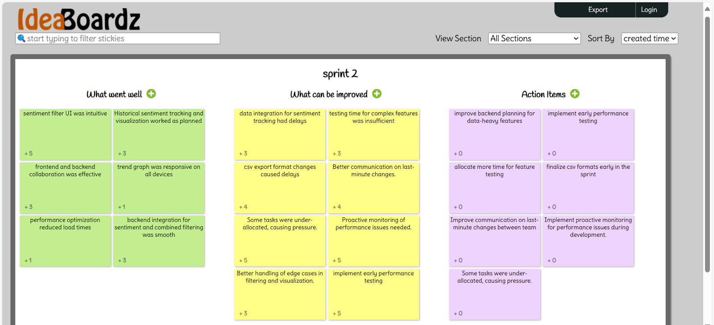
Retrospective

Slide 44
Sprint 3 Backlog
ID | Description | Acceptance Criteria | Feature | Story Points
US3.1 | As an investor, I want to filter articles based on both stock symbols and sentiment to focus on the best insights for my trading decisions. | Apply filters for symbols and sentiment. Filtered news updates in real time. | Combined Filtering | 5
US3.2 | As an investor, I want to export sentiment analysis and news data to a CSV file to analyze it offline. | Provide option to export data to CSV. Export includes stock, sentiment, and news. | Data Export | 3
US3.3 | As an investor, I want to view historical sentiment trends for a particular stock symbol to analyze long-term market sentiment. | Sentiment trends shown graphically. View trends for different time periods. | Historical Trends | 8
US3.4 | As an investor, I want to reset all filters easily to return to the full, unfiltered news feed. | Provide a clear option to reset filters. Reset clears all active filters. | Filter Reset | 2
TT3.5 | Developer implements historical sentiment tracking and visualization. | Track and store historical sentiment. Display trends using a graph. | Historical Sentiment Graph | 8

Slide 45
Sprint 3 Backlog
ID | Description | Acceptance Criteria | Feature | Story Points
TT3.6 | Developer improves frontend performance and responsiveness. | Optimize UI for mobile and desktop. Ensure fast filter application. | Frontend Optimization | 5

Slide 46
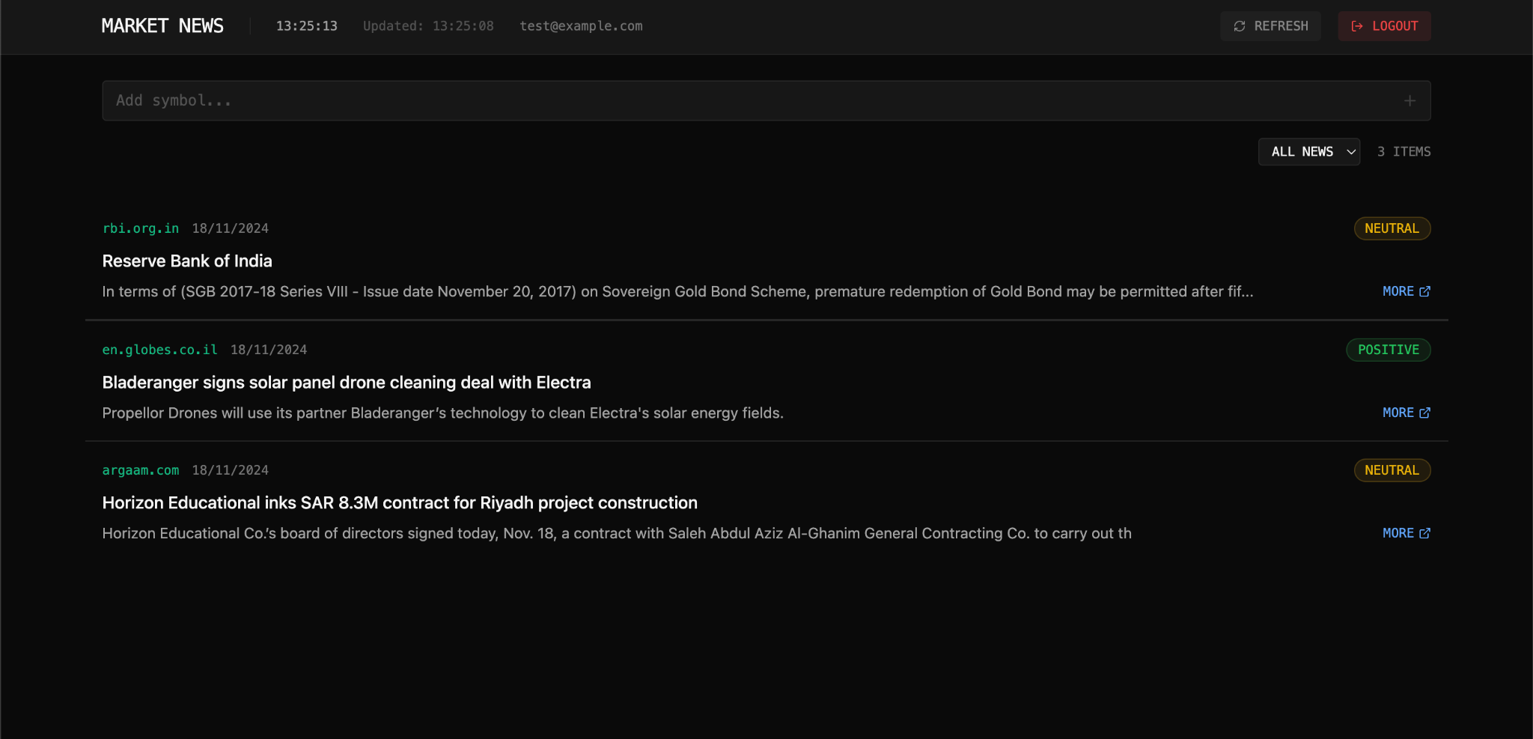
App Screenshot

Slide 47
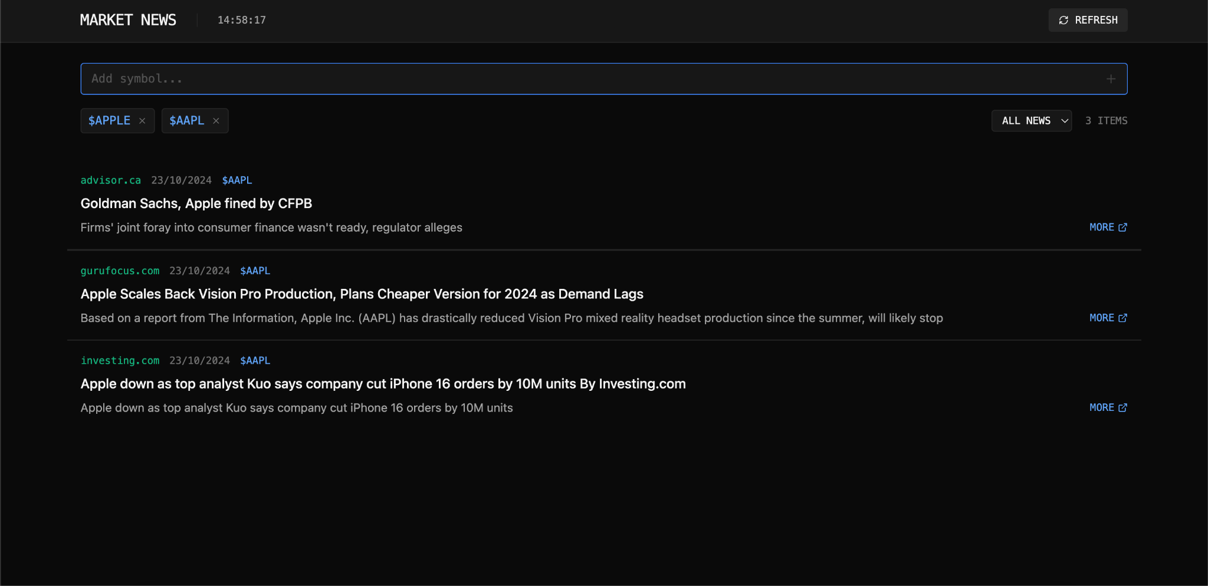
App Screenshot

Slide 48
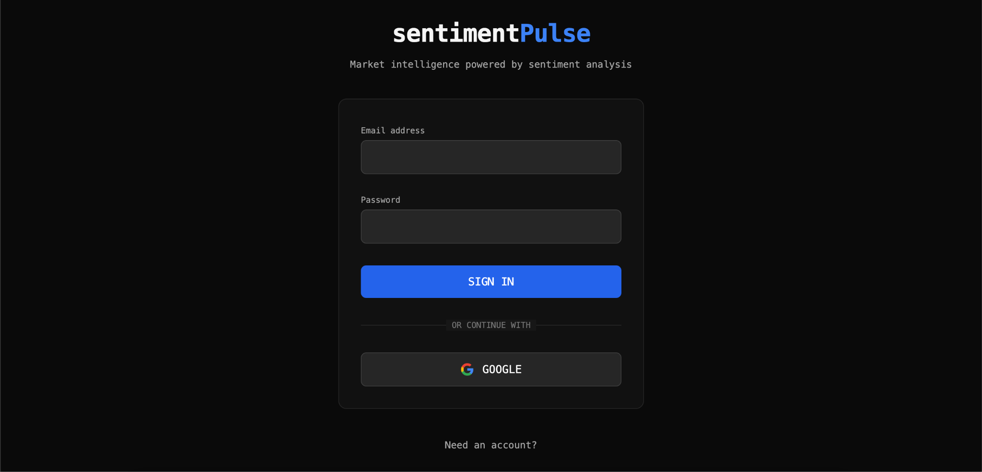
App Screenshot

Slide 49
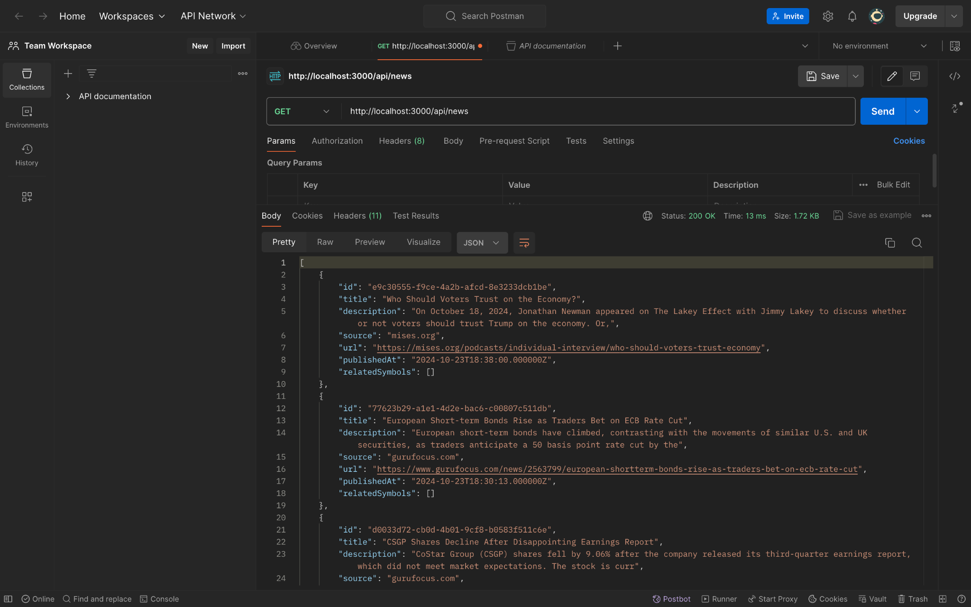
API

Slide 50
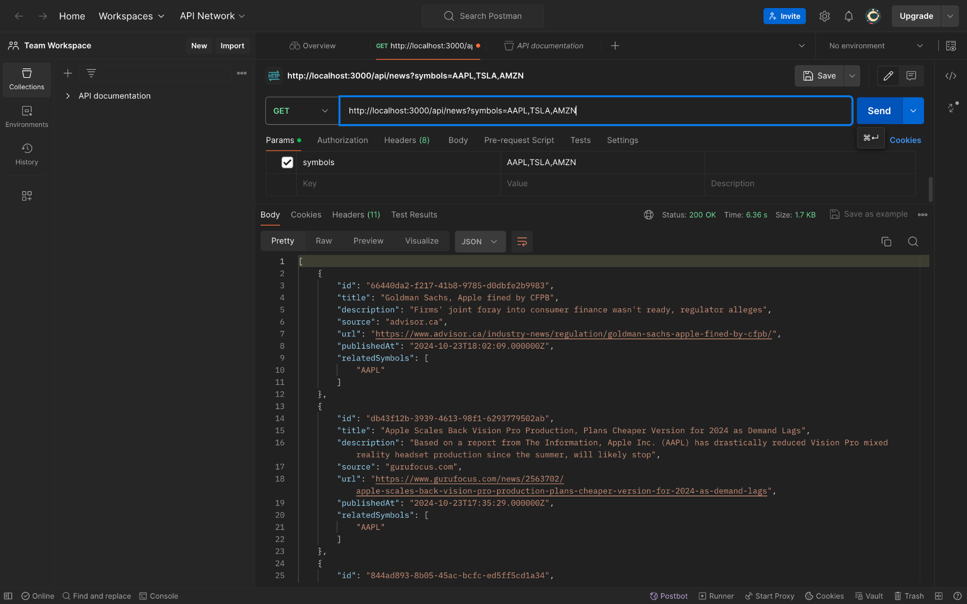
API

Slide 51
WikiPage
https://github.com/htmw/2024F-Team-Spirit/wiki

Slide 52
Application Demo
LIVE

Slide 53
Thank you

